Slide 1



UNIT 3
LESSON 11
Crazy about sports
Part 3

Slide 2
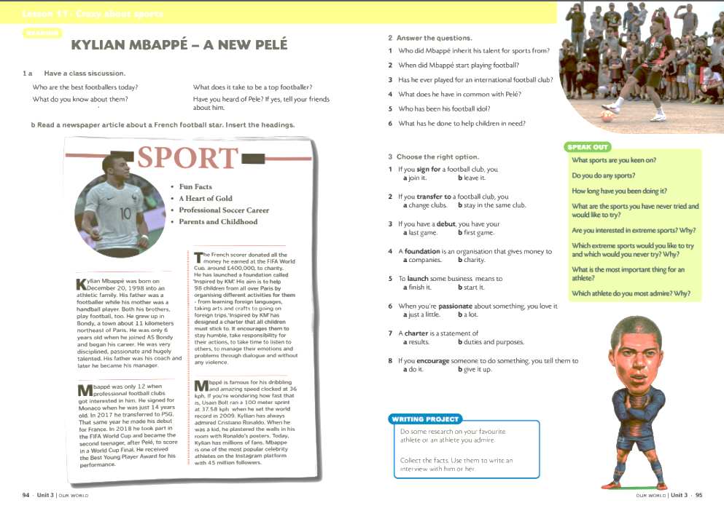
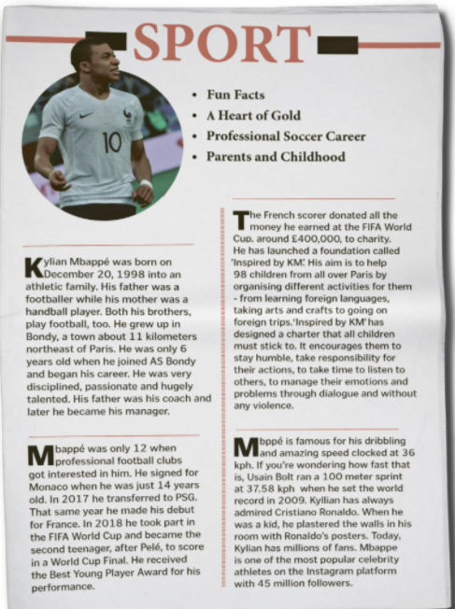
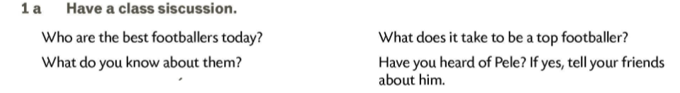
BRAINSTORMING
FOOTBALL
A Heart of Gold
Parents and Childhood
Professional Soccer Career
Fun Facts

Slide 3
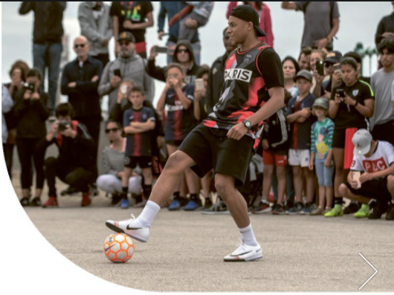
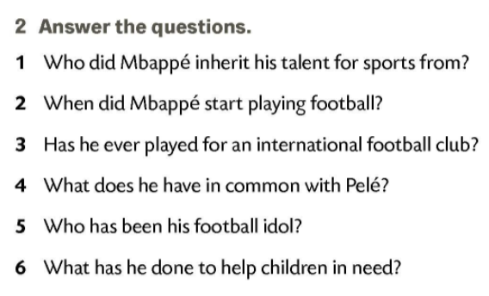
1 From both his mother and father.;
2 When he was 6 years old.;
3 No, he hasn’t.;
4 He scored a goal in the FIFA World Cup when he was a teenager just as Pele did.;
5 Christiano Ronaldo.;
6 He has launched a foundation called Inspired by KM. The aim is to help 98 children all over the world.

Slide 4
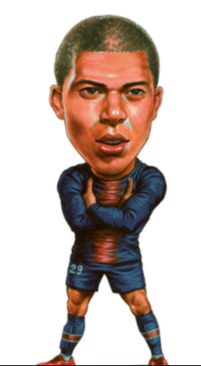
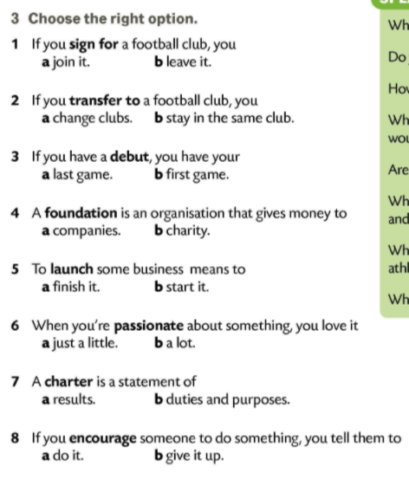
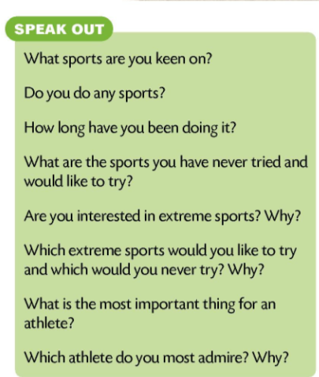
Have you seen Mbappé play?
What do you think about him?
Who is your favourite footballer?

Slide 5
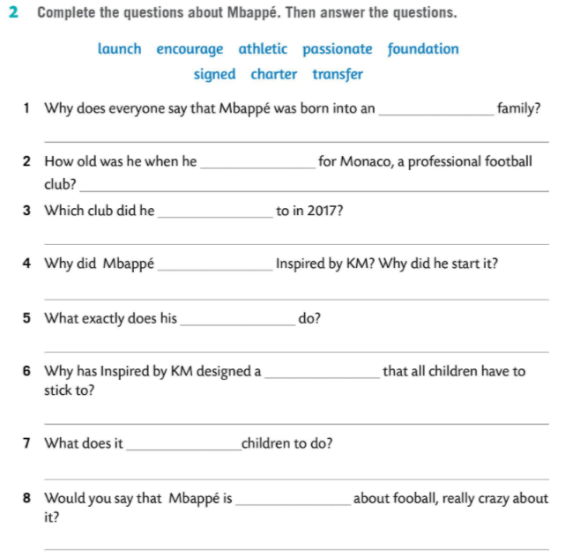
athletic
Because his dad was a footballer, his brothers are footballers and his mum was a handball player. They are all athletes.
signed
He was just 14 years old.
transferred
In 2017 he transferred to PSG.
found
He started his foundation to help 98 children all over Paris.
foundation
It organizes different activities for children: from learning foreign languages, taking arts and crafts to going on foreign trips.
charter
To teach them things important in life; be humble, responsible, feel empathy for others, and not to be violent.
encourage
To stay humble, take responsibility for their actions, listen to others, manage their emotions and problems through dialogues and without any violence.
passionate
Yes, he is completely devoted to it.

Slide 6
